Slide 1
Low-pass Filter
High-pass Filter
Band-pass filter
Notch filter

Slide 2
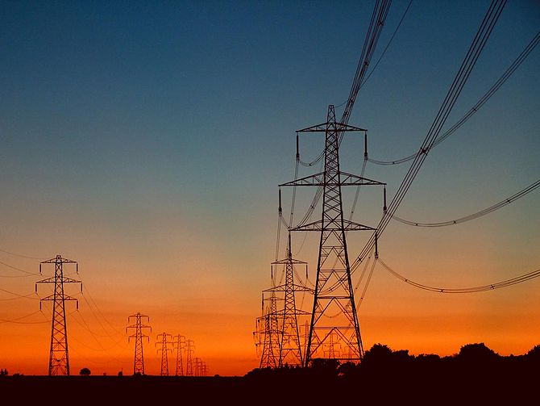
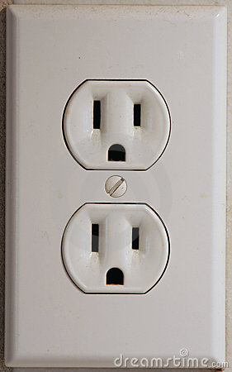
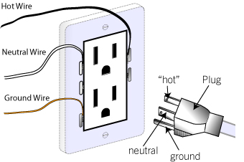
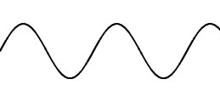
The AC Power Grid
60 Hz, 120 V_{RMS}

Slide 3
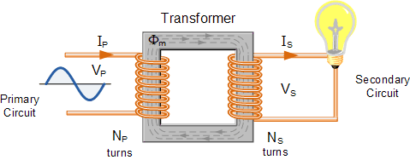
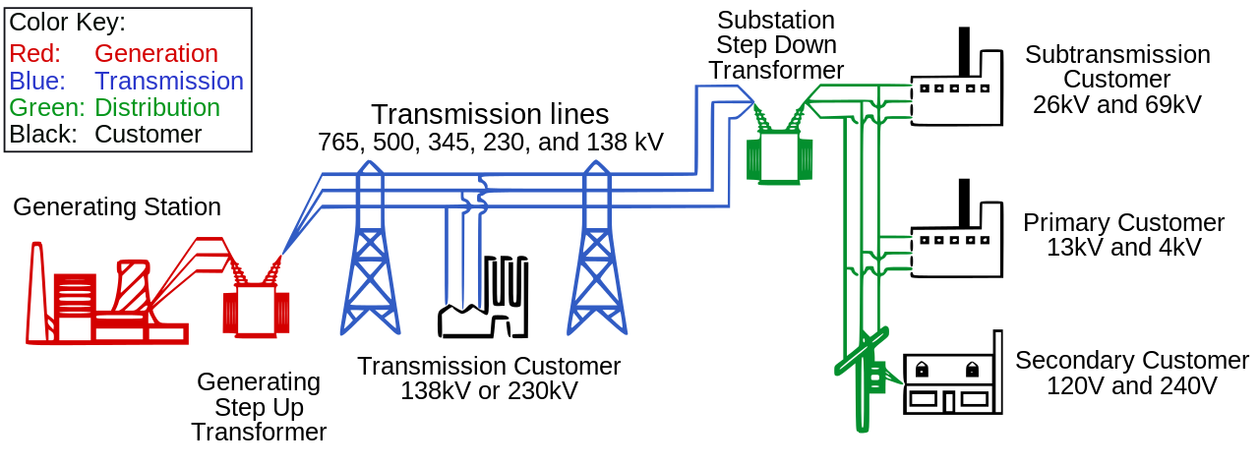
High Voltage Transmission Lines
AC voltages can easily be increased using a transformer.

Slide 4
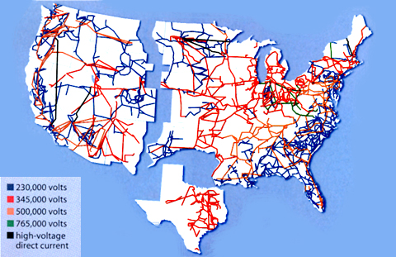
The AC Power Grid
Electrical energy distributed across nation via AC transmission lines.
https://www.technologyreview.com/s/401083/a-smarter-power-grid/

Slide 5
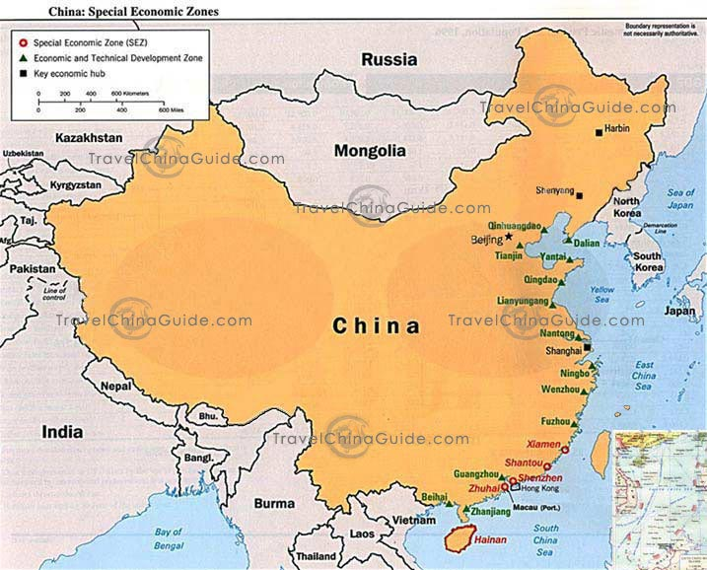
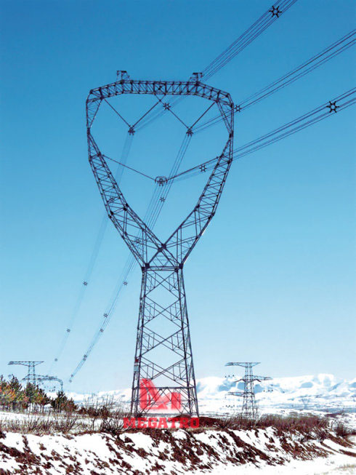
Power Grids of the Future
Power in sent across the country by 1 Million volt transmission lines!
In China, much of the population lives on the east coast.
But most of the energy resources are located in the west.

Slide 6
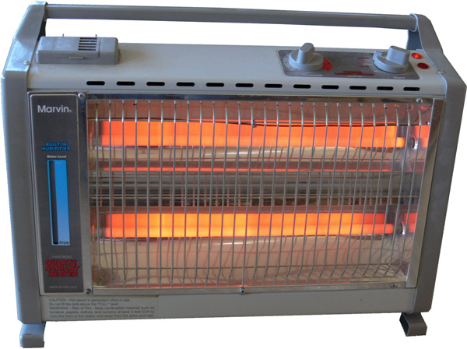
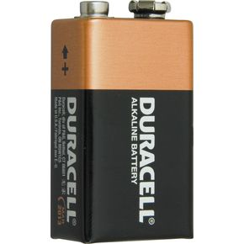
Non-ideal Power Supply
Power supplies and batteries have an “internal resistance” or “output impedance” that limits the amount of current it can output.

Slide 7
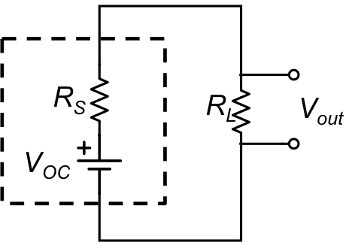
Non-ideal Power Supply
Power supplies and batteries have an “internal resistance” or “output impedance” that limits the amount of current it can output.
Voltage “Droop”

Slide 8
Non-ideal Power Supply
Power output depends on load resistance R_{L}
q_{L}
Max power occurs when
R_{L} = R_{S}
“Impedance matching”
R_{L}

Slide 9
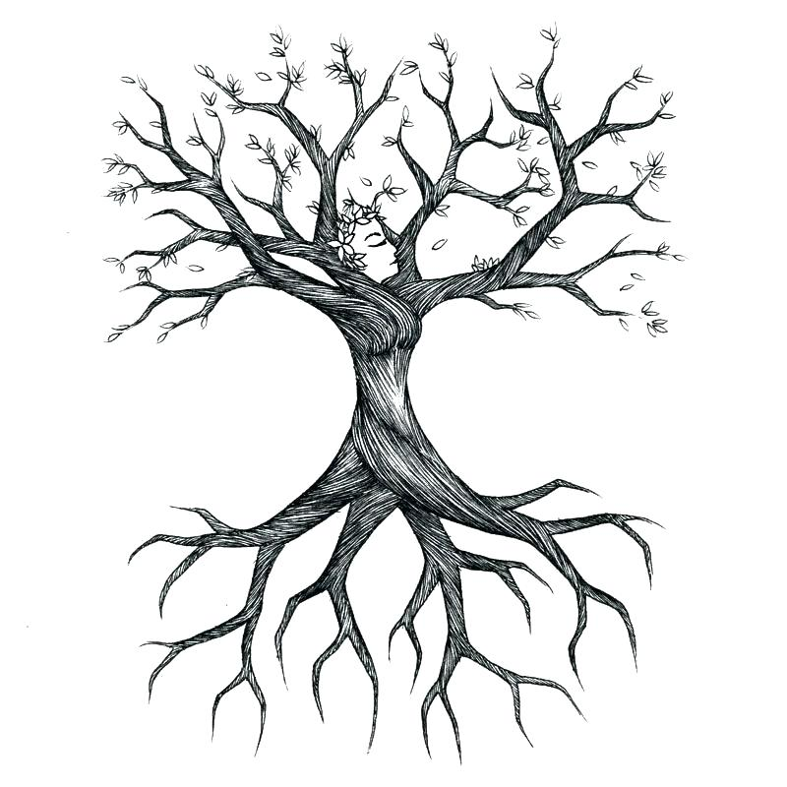
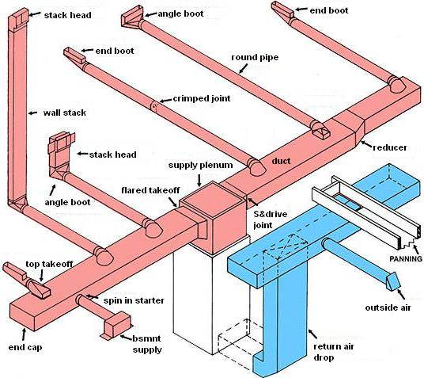
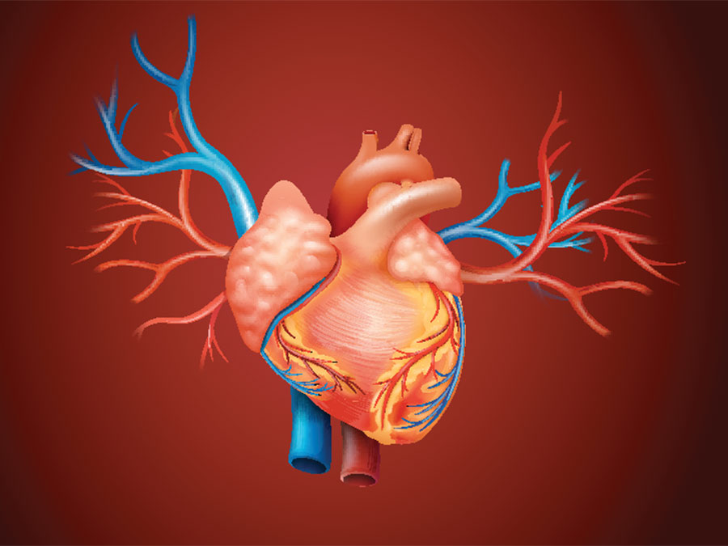
Impedance Matching
Subsequent branches are “impedance matched”

Slide 10
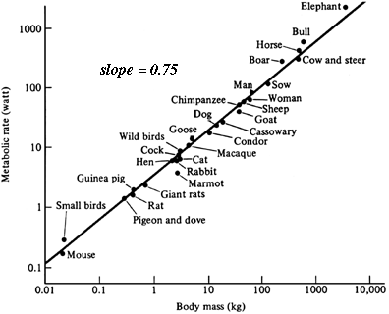
Power Law Scaling
Kleiber’s Law
Metabolic rate vs. mass
http://eesc.columbia.edu/courses/ees/life/lectures/lect03.html

Slide 11
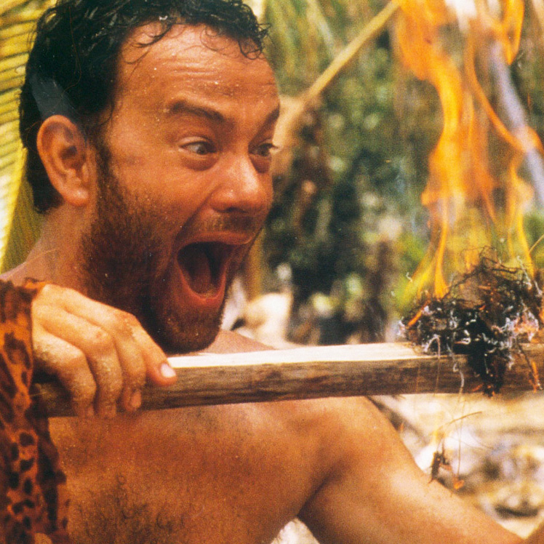
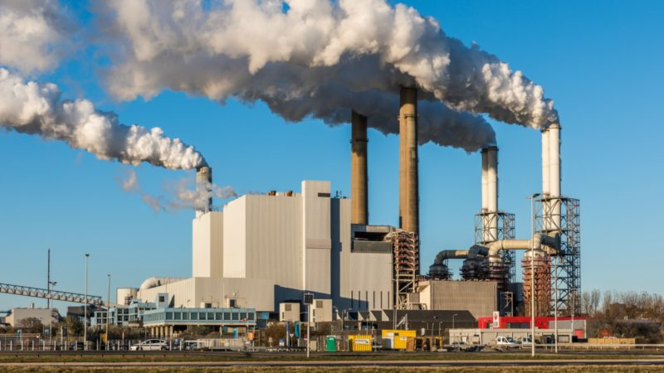
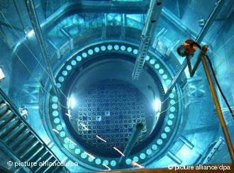
Energy Consumption
Human metabolism ~ 100W
Human “social metabolism” ~ 10,000W

Slide 12
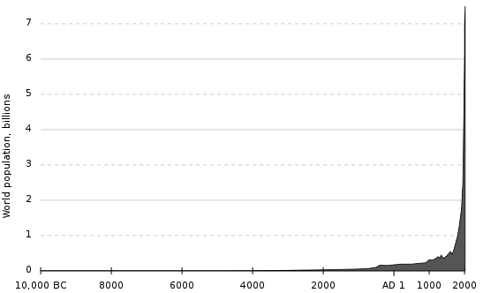
Energy Consumption
Population over 7 billion and growing!
https://en.wikipedia.org/wiki/Human_overpopulation#/media/File:Population_curve.svg

Slide 13
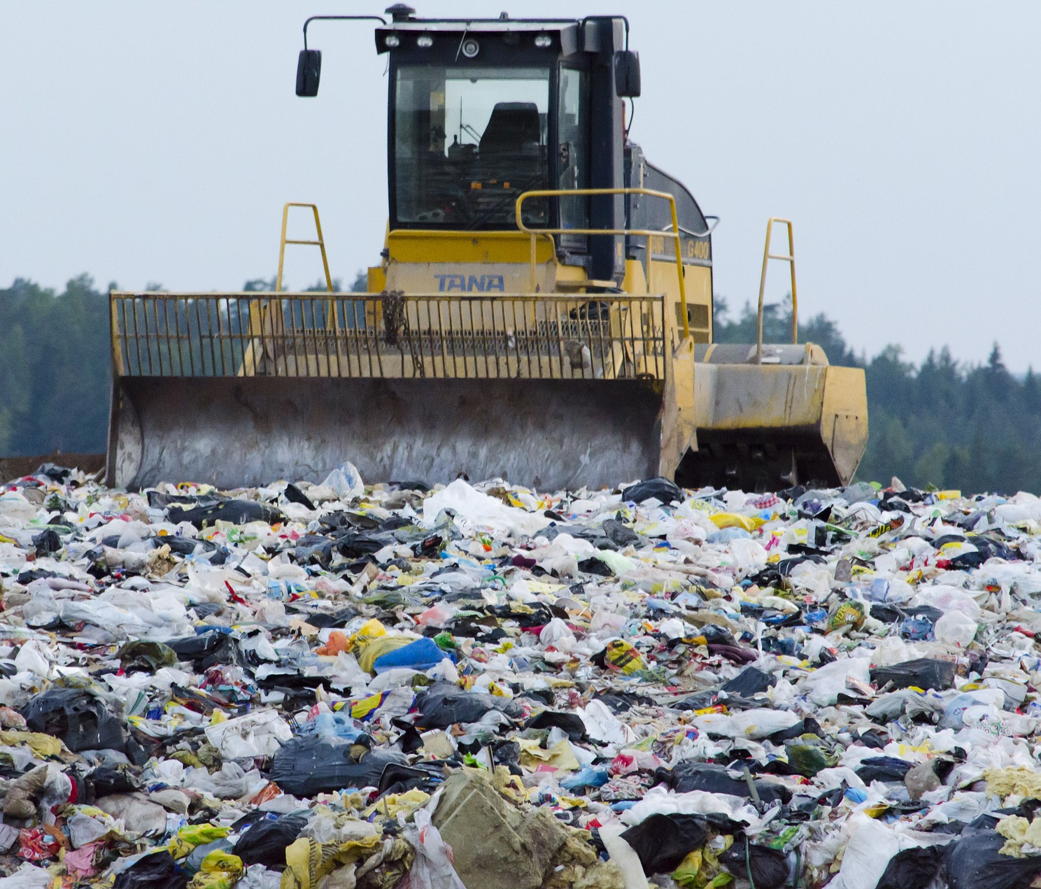
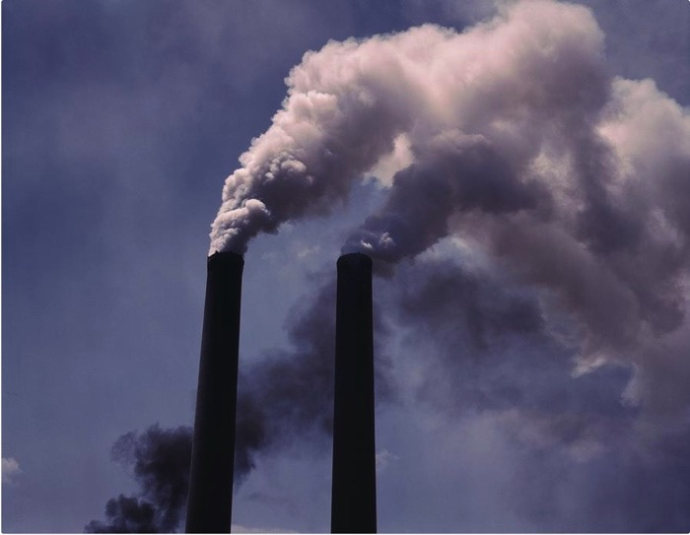
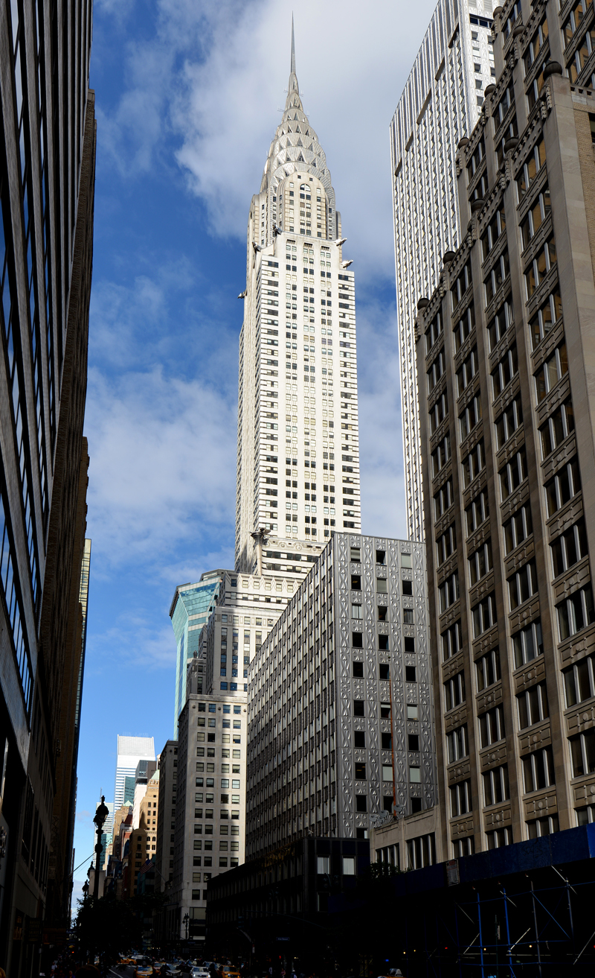

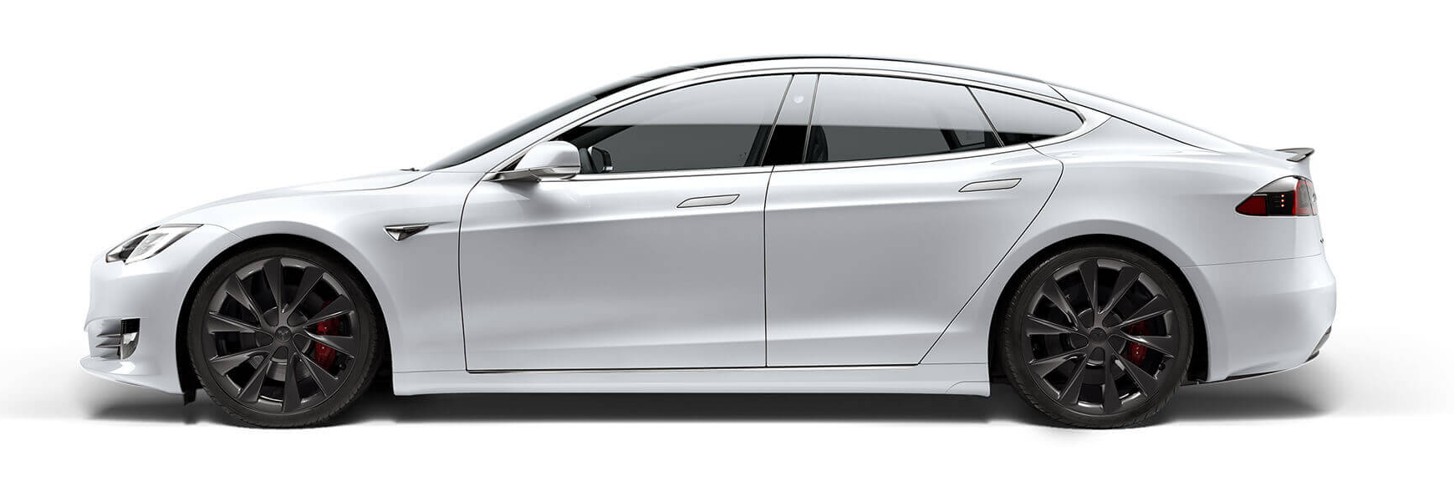

Energy Consumption
Entropy
Output
Waste heat:
2x10¹² W (3 TW)
Energy Input
Work Output
Economy
GDP and $$$
3x10¹² W (3 TW)
~10,000W per person!
1x10¹² W (3 TW)

Slide 14
Energy Consumption
https://science.energy.gov/bes/community-resources/reports/

Slide 15
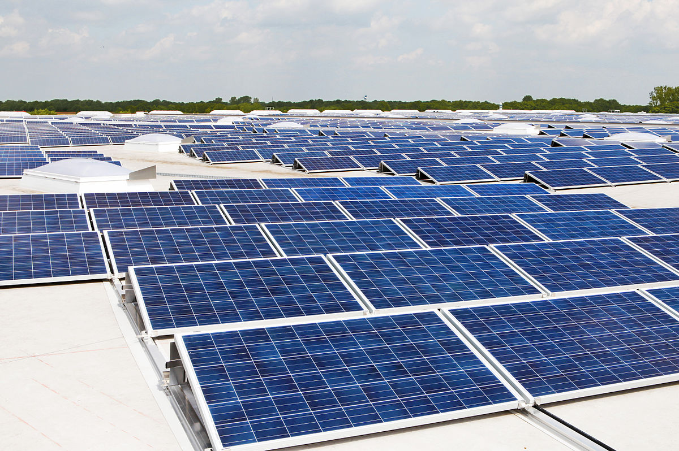
A6/A7 – Solar Panels

Slide 16
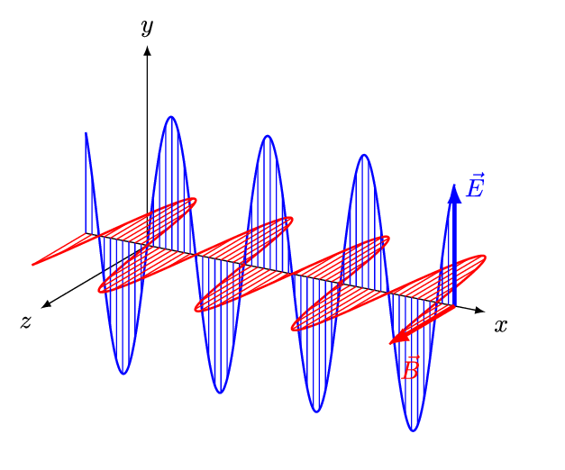
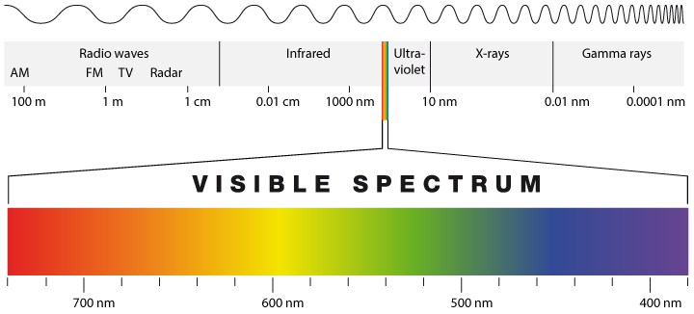
What is Light?
Light is an electromagnetic wave that travels at the speed of light.
“Visible Light” has a wavelength in the 400 – 700nm range.
Wavelength determines color.

Slide 17
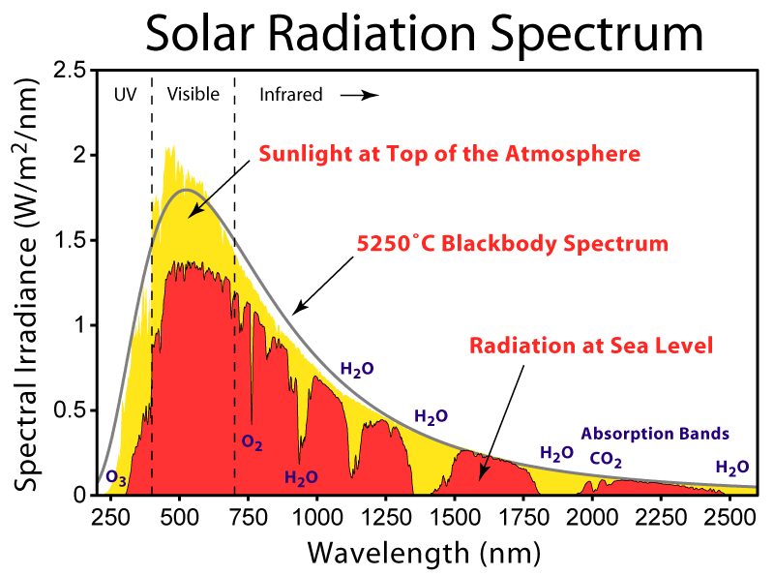

Slide 18
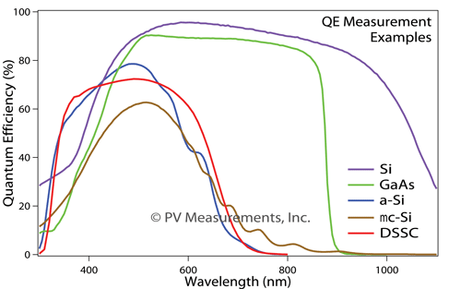
Spectral Response of a Solar Panel
Different types of solar panels are sensitive to different colors of light.
https://www.quora.com

Slide 19
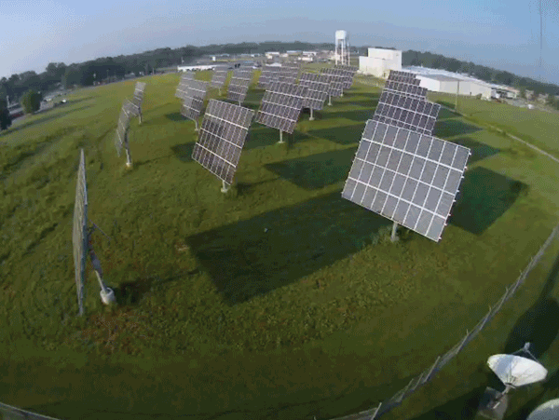
Solar Panel Tilt

Slide 20
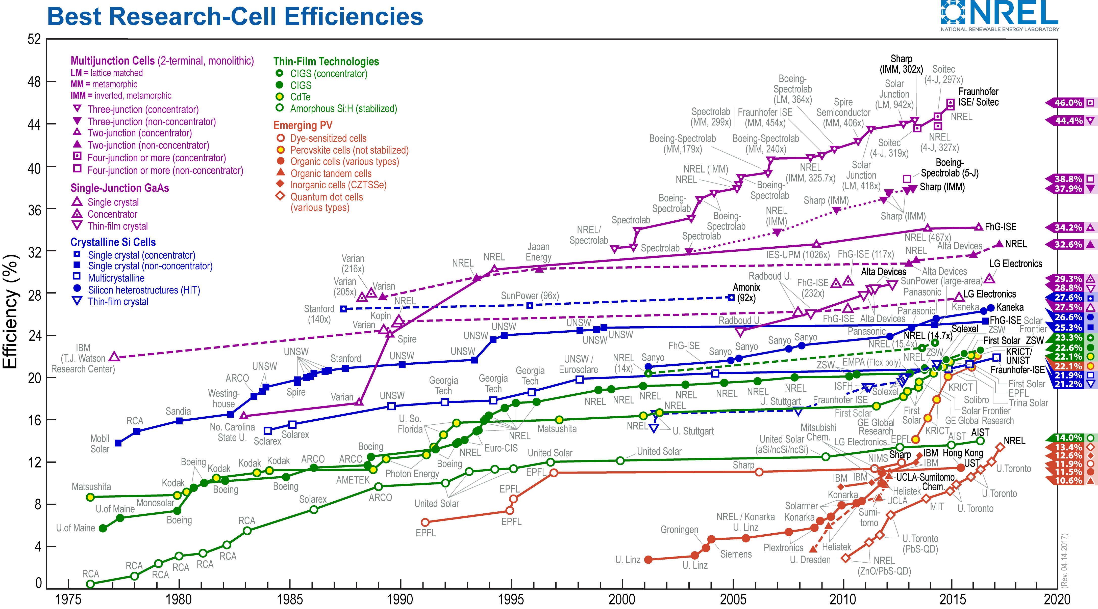
Solar Panel Efficiency
https://www.nrel.gov/pv/assets/images/efficiency-chart.png

Slide 21
Energy Storage
?
?
?
?

Slide 22
